Slide 1


Combining WSO2 API Manager with WSO2 BAM for Billing in the Energy Industry
Mohamed EL Marzgioui, Senior Consultant, Yenlo
Sumedha Rubasinghe, Director - API Architecture, WSO2
27 May 2014

Slide 2


About the presenters
Mohamed EL Marzgioui
Senior Consultant, Yenlo
Mohamed EL Marzgioui is a Senior Consultant at Yenlo. He has an engineering degree & certified oracle/java and is passionate by WSO2 technologies. For over four years he worked in integrating different systems and applications in banking industries (Business Banking , Corporate & Investement Banking ). He will take the stage on numerous international presentations to share his experience and passion.
Sumedha Rubasinghe
Director - API Architecture, WSO2
Sumedha focuses on development of the WSO2 Carbon Core, WSO2 Data Services, WSO2 Governance Registry, WSO2 Business Activity Monitor, and WSO2 API Manager. He has contributed to the successful implementation of data, SAP and repository-based integration projects, as well many WSO2 QuickStart development consulting engagements. He is an active committer with the Apache Axis2 project.

Slide 3
Agenda
With help of WSO2 API Manager, companies can cut their time to market dramatically. This webinar demonstrates how a large energy company makes use of the capabilities of WSO2 API Manager to do just that
Using the API manager (in general)
Using Puppet scripts for automatic deployment
AWS for cloud website hosting
Combining WSO2 API Manager with WSO2 BAM for billing
Using WSO2 Identity Server for central identity management

Slide 4






Our integration platform

Slide 5
WSO2 API Manager
Publishing API
Development community management
Scalable routing traffic
API Life cycle management
Fully compatible with other WSO2 products

Slide 6
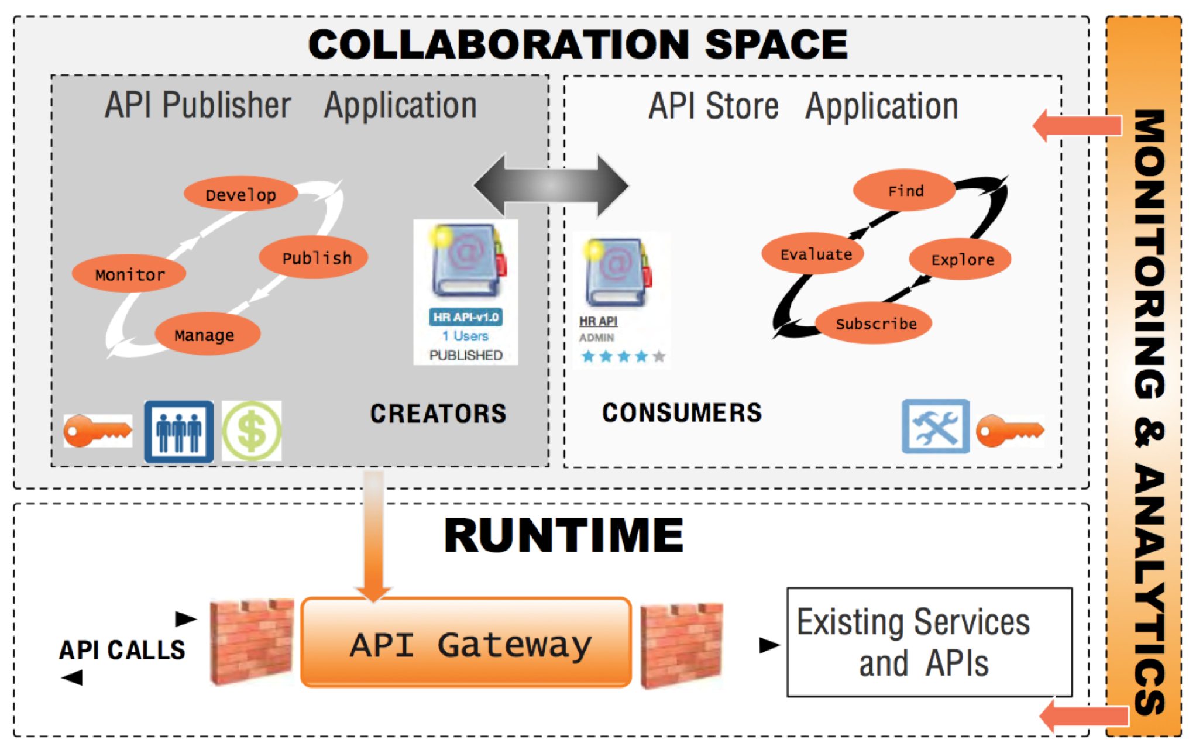
API Manager Architecture

Slide 7
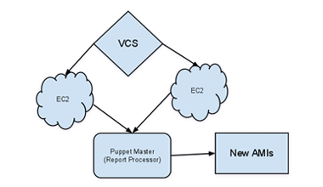
Puppet
Make rapid changes and enfore consistency of systems, applications and devices
DevOps Time to market
Monitoring enrollment
Install and configure WSO2 instances
Enroll Amazon EC2 instances
Install secure baseline

Slide 8
Amazon web services
Easy usage
Easy scalable
DevOps ready
Pay for what you use
Automatic stop and start our Dev and Test
Cost saving
Out of the box components

Slide 9
Case study
Billing user for the use of backend services
Provide detail information for each consumer of each service consumed
Manage versions of services
Little time to market

Slide 10
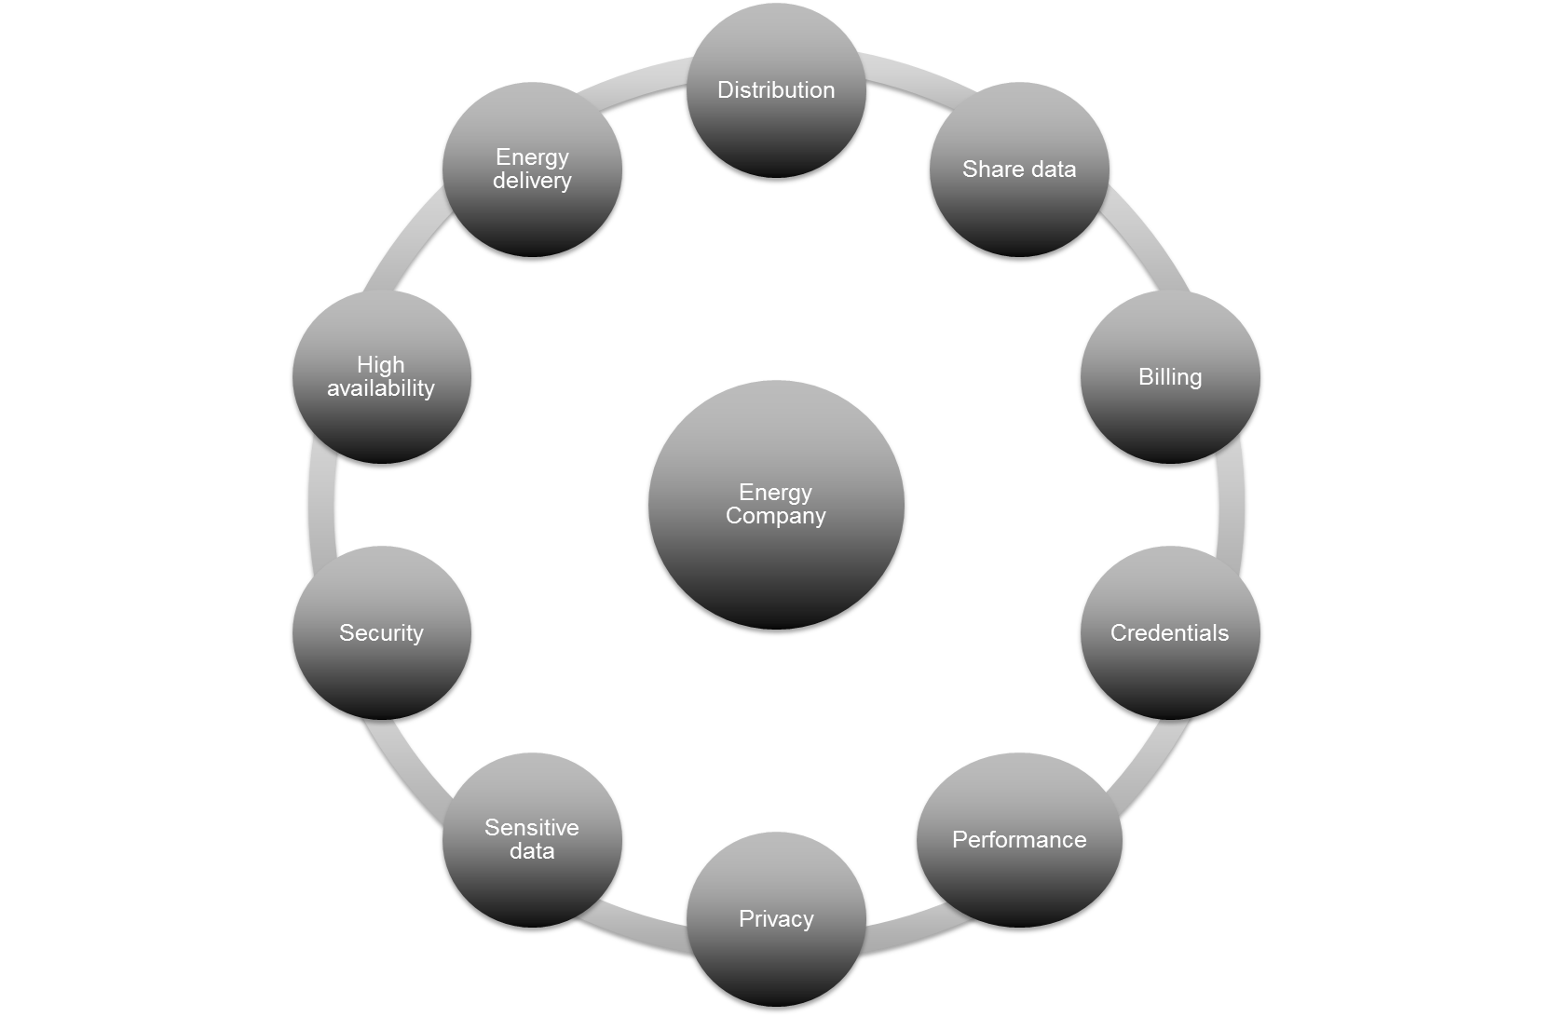
Brainstorming

Slide 11
Challenges
Provide a secure interface for the client
Thoroughly manage the clients credentials
Trace/Manage each request of the client
Provide high availability
Guarantee performance
Maintain customer privacy

Slide 12

The use of API Manager
Secure services
Easability
Billing
Only expose the right services
Easy scalable

Slide 13
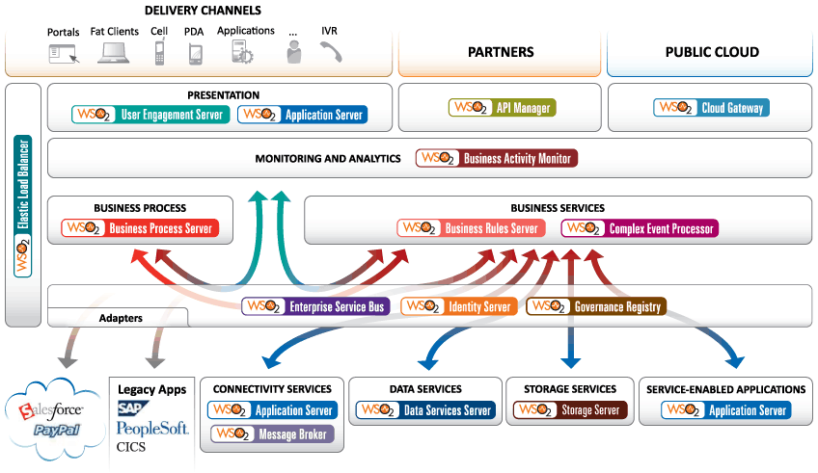
API Manager

Slide 14

Publish/Subscribe/Consume Workflow
2.Subscribe to API
API Store
1.Publish API
3.Consume API
API Publisher
API Gateway
4.Call backend service
Back end services

Slide 15
Setting up The API Manager
Public
API
Gateway
API
Store
API
Gateway
API
Store
API
Gateway
API
Store
Private
API
Publisher

Slide 16

Global view
Public
(DMZ)
Load balancer - AWS
API Store
API Gateway
API Gateway
Verifying…
Internal network
Load balancer - AWS
API
Publisher
Identity Server
ESB
ESB
BAM
BAM
Notes:
This is a simple and modest design how the system works .
First of all as you can see we splitted the API Manager into 3 (Gateway, Store and publisher) component this is much, easier manageable for the production environment
We configured API Gateways & the API Store on a DMZ network available for the clients, this way the client can consume a service or subscribe to one.
We have the ESBs BAMs and the API publisher on an internal network through which it can communicate with the API Gateways and Store
This architecture responded to the requirements of alliander
I would like to explain this architecture through a use case we can all enrolle together to day
First we have a client’s request the comes through the API Manager via AWS Load balancer(we will be talking about amazone later)
Second the api manager forwards it to the Identity server for the request to be authenticated
Once the request is authenticated it verify if it has surpassed the number of request allowed on the requested service
API Gateway notify the BAM providing all information that needs to be stored
Forwards the request to the ESB and returned the result

Slide 17
What’s new in API Manager 1.7.0?
API Design Wizard
Support for OAuth2 Scopes
Statistics Dashboard for developers
Multi tenant workflow support
Workflow integration for token generation
URL templating support for API definition
Customisable Store themes for tenants
Forum Support - API Store
Visibility Control for Documentation
Statistics dashboard for southbound API calls
Using Windows Authentication for OAuth2 Token generation

Slide 18
Questions & Answers

Slide 19

About WSO2
Global enterprise, founded in 2005 by acknowledged leaders in XML, web services technologies, standards and open source
Provides only open source platform-as-a-service for private, public and hybrid cloud deployments
All WSO2 products are 100% open source and released under the Apache License Version 2.0.
Is an Active Member of OASIS, Cloud Security Alliance, OSGi Alliance, AMQP Working Group, OpenID Foundation and W3C.
Driven by Innovation
  Launched first open source API Management solution in 2012
  Launched App Factory in 2Q 2013
  Launched Enterprise Store and first open source Mobile solution in 4Q 2013
Generated 2x revenue growth in 2013 and 2012
Captured 65 new customers in 2013
Obtained $20 M of funding from CISCO and Toba Capital

Slide 20
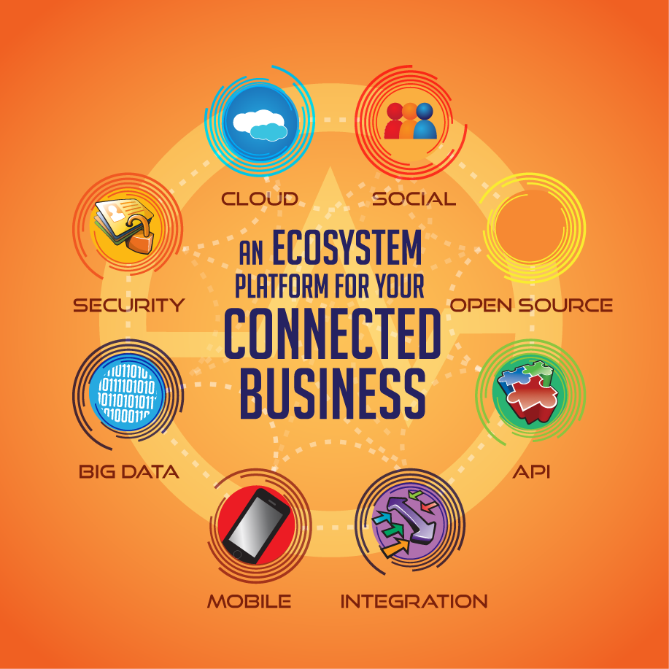
What WSO2 delivers

Slide 21
About Yenlo
Global enterprise, founded in 2007 with an international focus on delivering integration solutions based on Java open source
#1 in the field of Integration Solutions
#1 in Managed Services for middleware environments
#1 Global Strategic Alliance partner of WSO2
WSO2 Product Support
WSO2 Development
WSO2 QuickStarts
WSO2 Training & Certifications
WSO2 24/7 Managed Services
WSO2 Events

Slide 22









Enterprise Architecture
Software Development
Managed Services
WSO2 Product Support
WSO2 Development Support
WSO2 QuickStart
WSO2 Training & Certifications
WSO2 Managed Services
WSO2 Events
What Yenlo delivers

Slide 23
Workshops & Trainings 2014
Free Workshop powered by WSO2, SUSE & Yenlo:
Join the Connected Business Revolution
Date | Location
11 June 2014 | Berlin
16 July 2014 | Stuttgart
3 September 2014 | Prague
10 September 2014 | Manchester
17 September 2014 | Vienna
24 September 2014 | Brussels
See all workshop and training details on www.yenlo.com

Slide 24
Download the webinar presentation on slideshare:
http://www.slideshare.net/YenloBV

Slide 25


